Slide 1





Nondeterministic Impact of CPU Multithreading on Training Deep Learning Systems
Guanping Xiao^{1,2}, Jun Liu¹, Zheng Zheng³, Yulei Sui⁴
¹ Nanjing University of Aeronautics and Astronautics, China
² State Key Laboratory for Novel Software Technology, Nanjing University, China
³ Beihang University, China
⁴ University of Technology Sydney, Australia
Oct 27, 2021
Wuhan, China

Slide 2
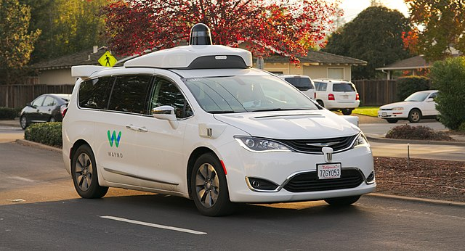
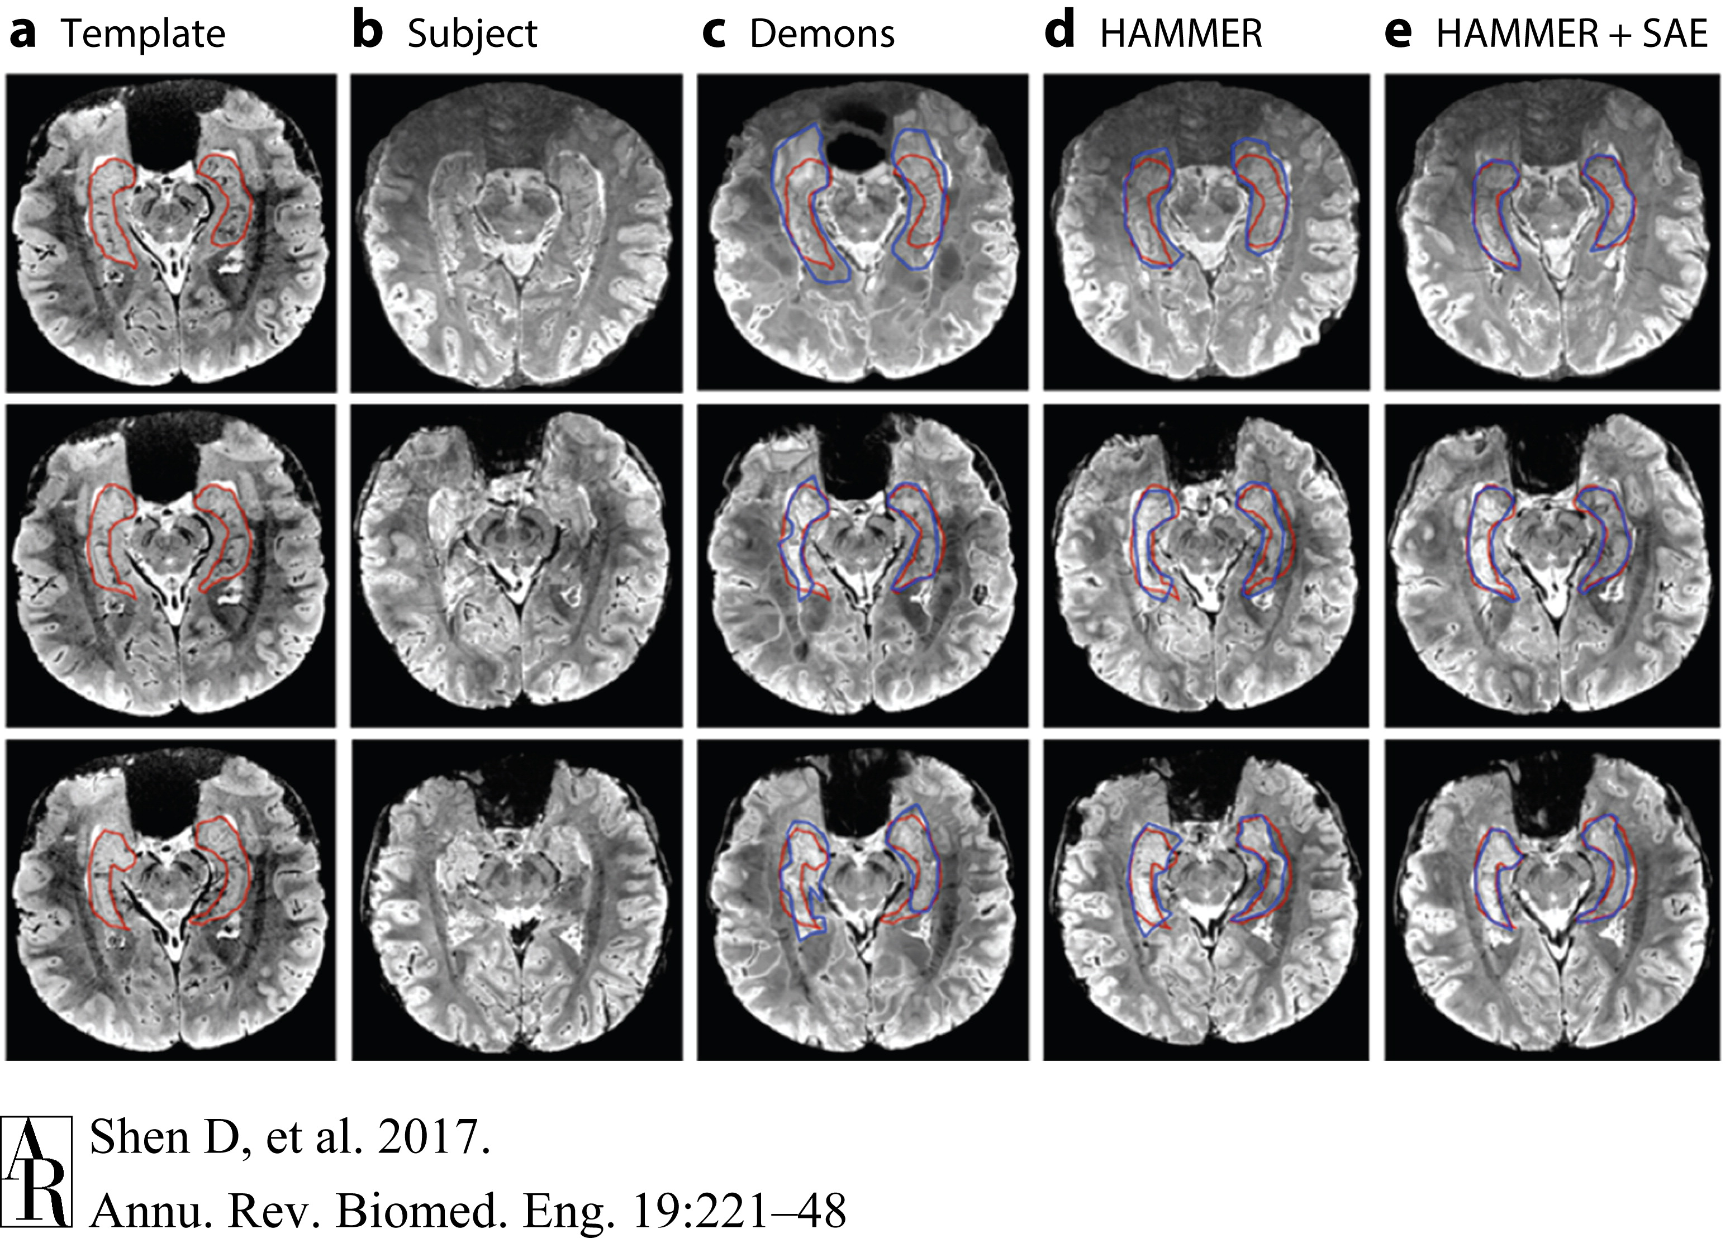
Motivation
Deep learning (DL) is widely used in various domains nowadays.
A reliable DL system is crucial, especially for safety-critical applications.
Self-driving Cars
Medical Diagnosis

Slide 3
Motivation
For reproducibility and stability purposes of using DL systems, it is expected that DL systems can have a deterministic behavior in identical training runs: under a fixed software-level and hardware-level experimental condition, multiple training runs produce the same model and result in identical evaluation results.
Unfortunately, DL systems are usually nondeterministic, i.e., multiple identical training runs can generate inconsistent models and yield different evaluation results.
Software-level and hardware-level nondeterminism factors.
GPU/CPU (rarely been studied)
weight initialization
shuffled batch ordering, etc.
Randomness

Slide 4
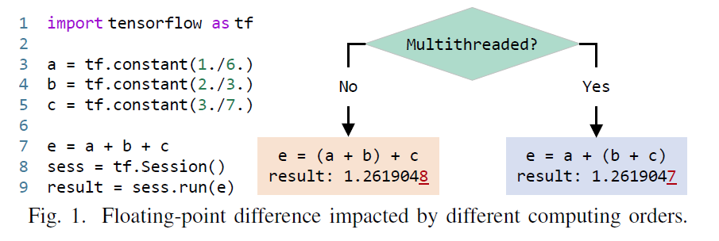
Motivation
Example: the expression e = a + b + c can be computed in two different ways:
e = (a + b) + c = 1.2619048
(2) e = a + (b + c) = 1.2619047
Floating-point imprecision

Slide 5
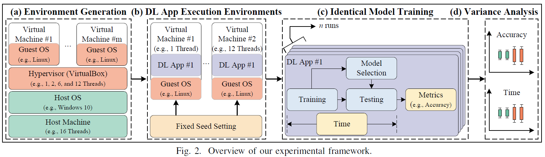
Experimental Framework

Slide 6
Research Questions
RQ1:
What’s the impact of CPU multithreading on the effectiveness variance (e.g., accuracy) in training DL systems?
RQ2:
What’s the impact of CPU multithreading on the time variance in training DL systems?
RQ3:
How many collected DL projects in GitHub clearly mentioned software and hardware requirements?

Slide 7
Contributions
An experimental framework based on VirtualBox for analyzing the impact of CPU multithreading on training DL systems
Six findings obtained from our experiments and examination on GitHub DL projects
Five implications to DL researchers and practitioners according to our findings
Released the research data (https://github:com/DeterministicDeepLearning)

Slide 8
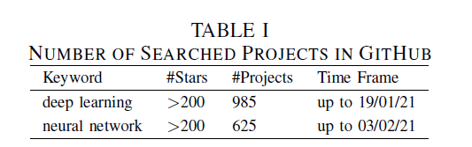
Data Collection and Aggregation
To collect our research data, we manually search projects with more than 200 stars in GitHub using two keywords, i.e., deep learning and neural network. After initial filtering, we gather a total of 1,610 projects, as shown in TABLE I.

Slide 9
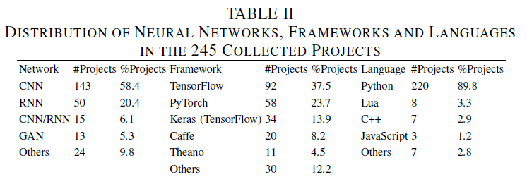
Data Collection and Aggregation
Data Clean (e.g., excluding non-DL projects)
Examined DL Projects (e.g., networks, frameworks, and languages)
Examine Requirements (software and hardware requirements)

Slide 10
Our Experimental Framework
Host Machine:
CPU: i9-9900K (8 cores 16 threads)
Memory: 64 GB
Storage: 2 TB HDD
Host OS: Windows 10 Pro (20H2)
Virtual Machine:
CPU Threads: 1/2/6/12 Threads
Memory: 24 GB
Storage: 500 GB
Guest OS: Ubuntu 18.04.5 LTS Desktop

Slide 11
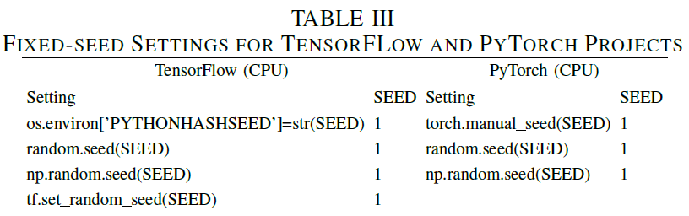
Our Experimental Framework
Control software-level randomness
e.g., Python/Numpy/TF random seed

Slide 12
Our Experimental Framework
Three types of identical training runs:
default runs with model selection
fixed-seed runs with model selection
fixed-seed runs without model selection
Variance analysis:
Boxplots and statistics test

Slide 13
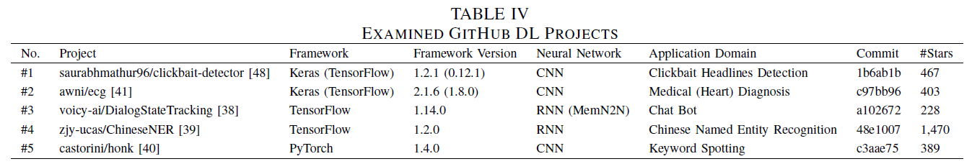
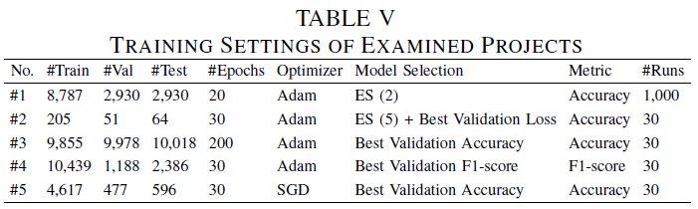
Our Experimental Framework
Details of examined DL projects
Five projects: two Keras, two TensorFlow, and one PyTorch

Slide 14
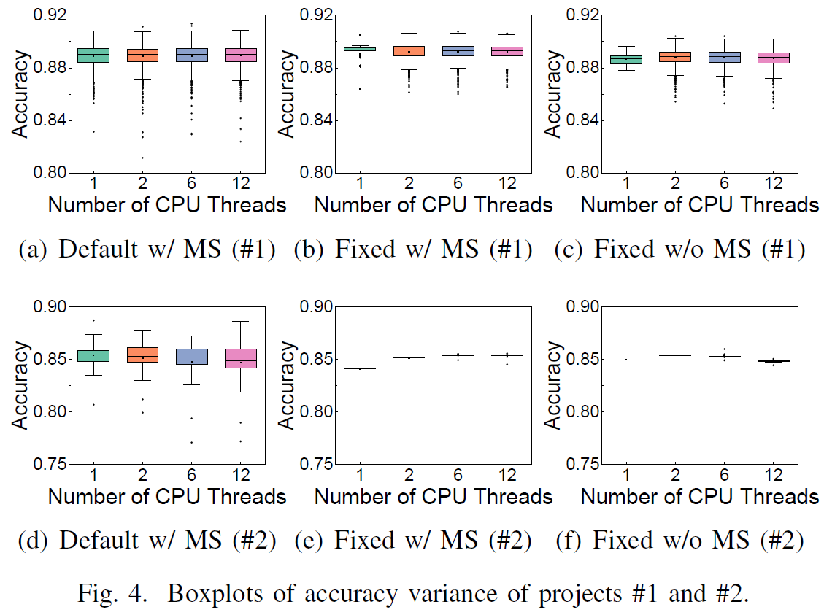
Results and Analysis
RQ1: Impact of CPU Multithreading on Effectiveness Variance
Finding #1: For the examined two Keras (with TensorFlow backend) projects, the accuracy variances obtained from default identical training runs (without controlling random generators) have no significant difference in different CPU multithreaded environments. The nondeterminism factors cause accuracy differences as large as 11.43%. However, after controlling random generators, we can observe the impact of CPU multithreading on the accuracy variance (e.g., different training accuracy).

Slide 15
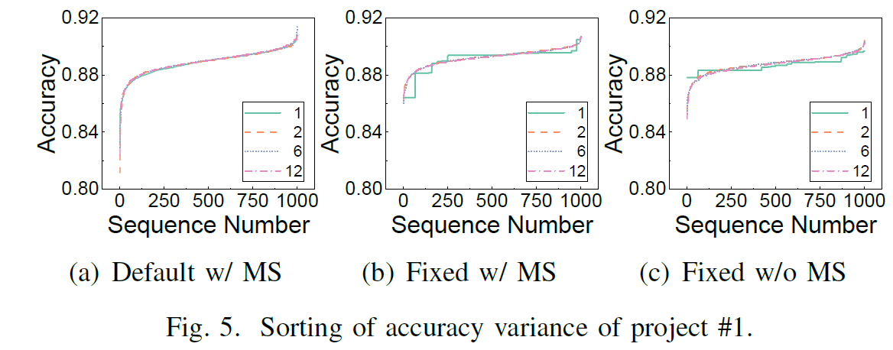
Results and Analysis
RQ1: Impact of CPU Multithreading on Effectiveness Variance
Finding #1 (cont’d): Although variance still exists in fixed-seed identical runs, some accuracy scores keep occurring in a single-threaded environment.
Single-threaded env:
89.39%-334 times
Single-threaded env:
88.33%-358 times

Slide 16
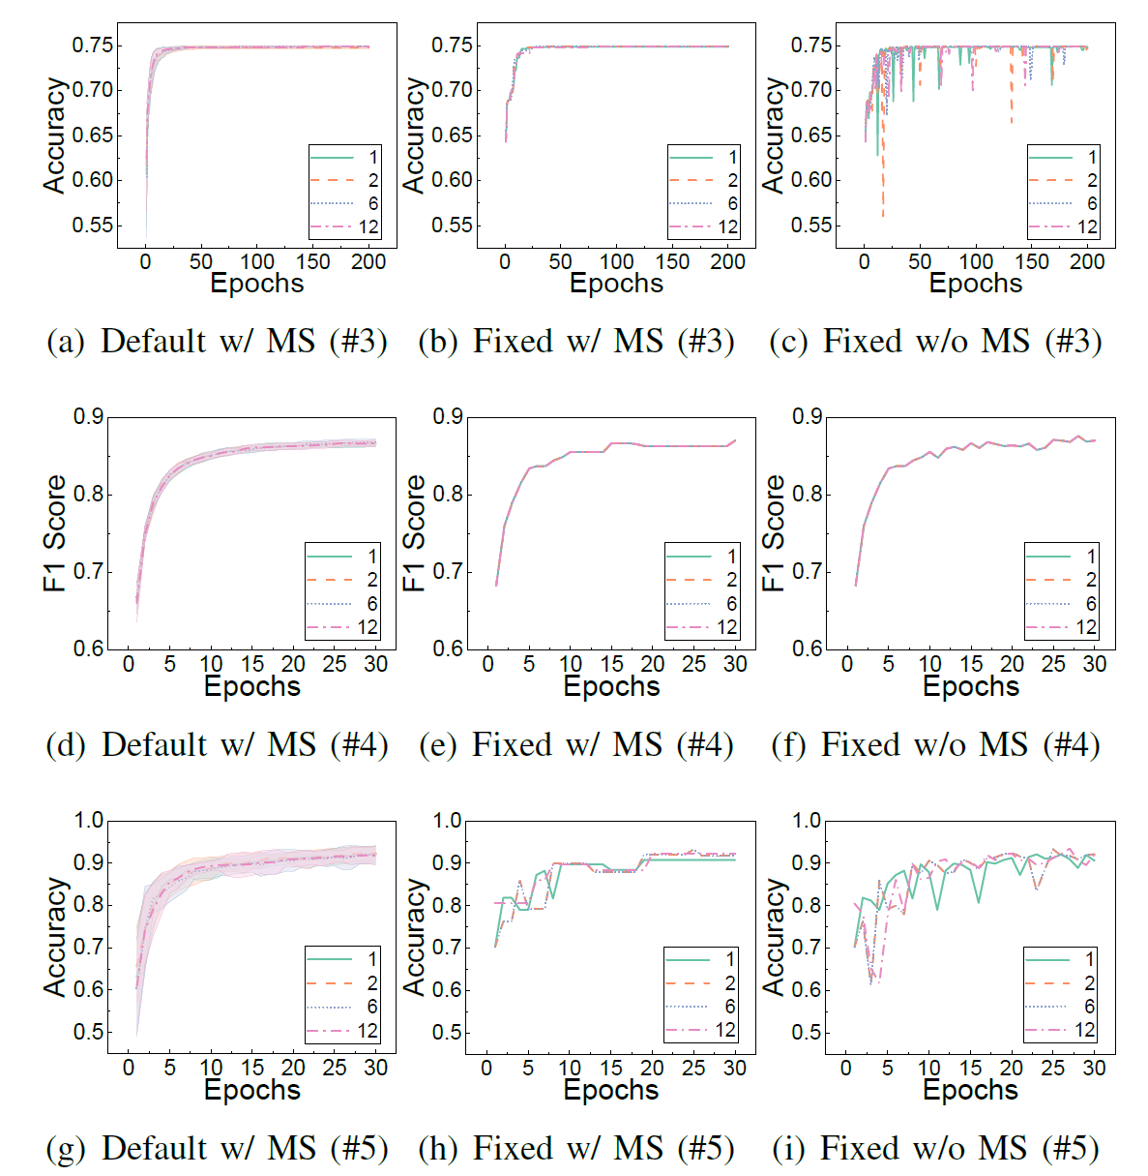
Results and Analysis
RQ1: Impact of CPU Multithreading on Effectiveness Variance
Finding #2: Similar to the Keras projects, for the examined TensorFlow and PyTorch projects, default identical training runs produce multiple models with different evaluation results. However, fixed-seed identical training runs produce deterministic evaluation results in the environment with the same number of CPU threads. The deterministic evaluation results of one project can be different across different environments.

Slide 17
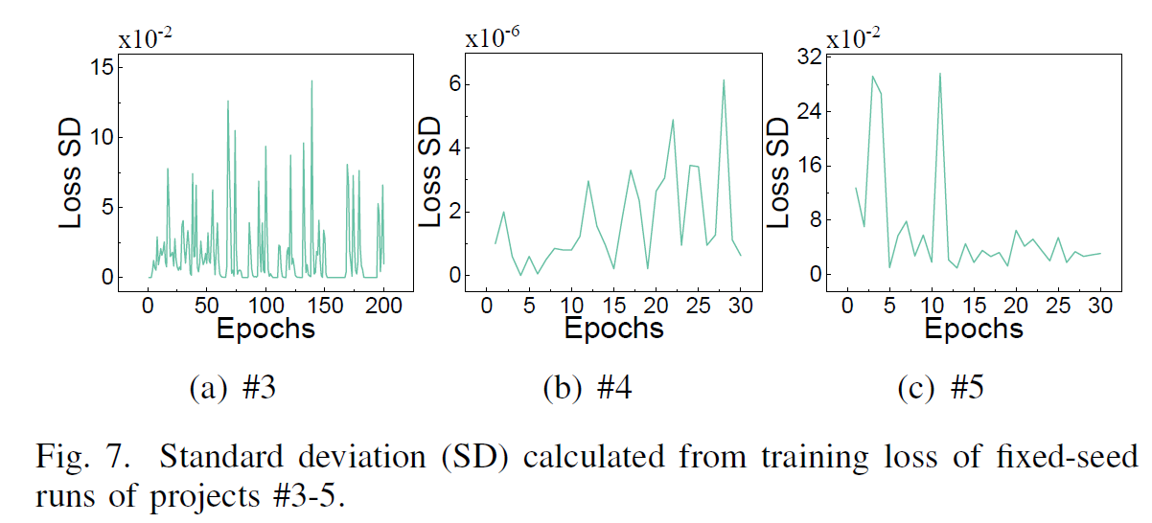
Results and Analysis
RQ1: Impact of CPU Multithreading on Effectiveness Variance
10⁻²
10⁻⁶
10⁻²
Finding #2: Similar to the Keras projects, for the examined TensorFlow and PyTorch projects, default identical training runs produce multiple models with different evaluation results. However, fixed-seed identical training runs produce deterministic evaluation results in the environment with the same number of CPU threads. The deterministic evaluation results of one project can be different across different environments.

Slide 18
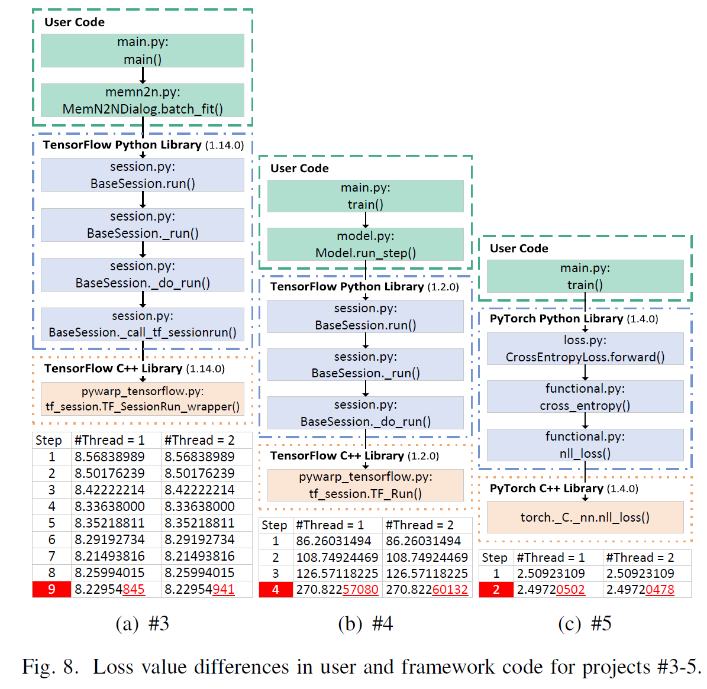
Results and Analysis
RQ1: Impact of CPU Multithreading on Effectiveness Variance
Finding #3: The rounding errors of floating-point numbers come from low-level implementations of DL frameworks, i.e., the C++ library. Under different CPU multithreaded environments, the rounding errors are accumulated during the training process. After some training steps, the values of training loss become different.

Slide 19
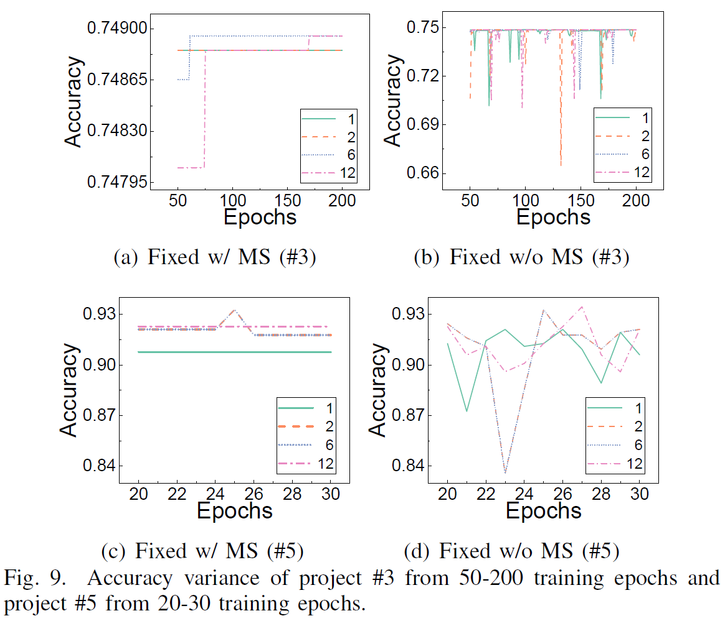
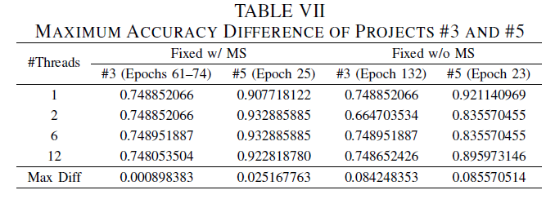
Results and Analysis
RQ1: Impact of CPU Multithreading on Effectiveness Variance
Finding #4: For fixed-seed identical training runs without model selection, CPU multithreading causes accuracy differences as large as 8.56%. Using model selection can minimize the impact of CPU multithreading on training DL systems. The max accuracy differences are range from 0.0898% to 2.52% with model selection.

Slide 20
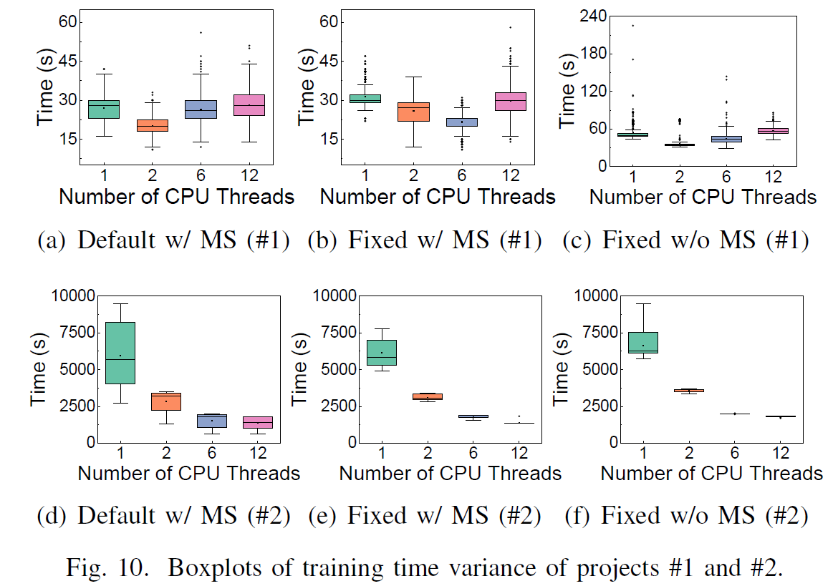
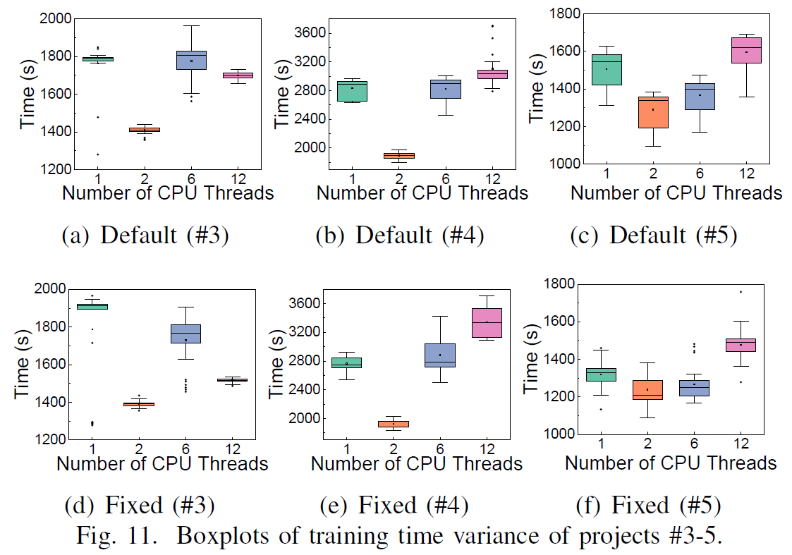
Results and Analysis
RQ2: Impact of CPU Multithreading on Time Variance
Finding #5: For the examined five DL projects, only one project shows that the training time would decrease along with the increasing number of CPU threads. For most projects, using 2 threads would be a better choice to obtain a faster training efficiency.

Slide 21
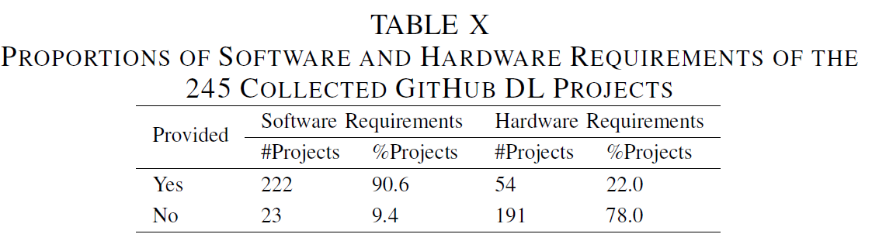
Results and Analysis
RQ3: Proportions of DL Projects that Mentioned Software and Hardware Requirements
Finding #6: Among the 245 collected GitHub DL projects, 90.6% of them provide software-level requirements, while only 22.0% mention hardware-level requirements. For the projects that have hardware requirements (54 projects), 94.4% present tested GPU environments, while 14.8% list tested CPU environments.

Slide 22
Implications for DL Researchers and Practioners
Implication #1: When training DL systems on CPU platforms, to obtain deterministic training results, developers should control software-level nondeterminism factors (e.g., random generators). Besides, practitioners should pay attention to the effectiveness variance under different CPU multithreaded environments.
Implication #2: The effectiveness variance introduced by CPU multithreading could be huge, in particular when training DL systems without using model selection techniques. To minimize the impact of CPU multithreading on the effectiveness variance in training DL systems, developers are suggested to use model selection methods (e.g., best validation loss/accuracy). Moreover, to achieve deterministic DL systems, it is necessary to develop mitigation techniques to eliminate the inconsistency of accuracy scores introduced by CPU multithreading.

Slide 23
Implications for DL Researchers and Practioners
Implication #3: Using more CPU threads for model training does not necessarily indicate that we can achieve faster training efficiency. DL models with a default setting (e.g., using all CPU threads) do not often take full advantage of computing capability of the underlying hardware [55]. For obtaining a promising training time, developers are suggested to use some auto-tuning tools (e.g., TensorTuner [35]) to fine-tune the built-in threading configuration in DL frameworks (e.g., TensorFlow).
Implication #4: When optimizing CPU parallelism for training DL systems, developers should pay attention to the potential impact on the effectiveness variance introduced by CPU multithreading. For example, it would be necessary to consider the task as a multi-objective optimization problem, i.e., minimize the training time and maximize the effectiveness (e.g., accuracy).

Slide 24
Implications for DL Researchers and Practioners
Implication #5: Developers are suggested to mention hardware environments used for model training and evaluation when releasing a DL project. In particular, if DL models are trained on CPU platforms, developers should provide detailed CPU models, since the number of threads used can affect model training and evaluation.

Slide 25
Contributions
An experimental framework based on VirtualBox for analyzing the impact of CPU multithreading on training DL systems
Six findings obtained from our experiments and examination on GitHub DL projects
Five implications to DL researchers and practitioners according to our findings
Released the research data (https://github:com/DeterministicDeepLearning)

Slide 26
Future Work
Collect and examine more DL projects (models)
Perform experiments on cloud platforms (e.g., using more powerful CPUs)

Slide 27
Thank you for your listening!
Q&A
Guanping Xiao
Email: gpxiao@nuaa.edu.cn
Homepage: https://guanpingxiao.github.io/

